Slide 1
Tutorial 2 Get familiar with VS Code & Makefile and String Applications
Sep. 19, 2022
Lai Wei (USTF)
(SDS, 120090485@link.cuhk.edu.cn)

Slide 2
Course unofficial WeChat group & Current Zoom ID
Zoom id: 263 720 5498 (no password)

Slide 3
Objectives today
Some background information about this course.
Two concepts clarification
Get familiar with some common operations of string (e.g., substr), which will be important in your Assignment 1!
Three examples with string operations:
Palindromes 回文数
Acronym 首字母缩略词
Pig Latin 儿童隐语
Learn to use VS Code and Makefile to run the examples above.
Q&A time: make sure you can run the C++ code on your computer now! (If you can’t, solve it today!)

Slide 4
1. Background
The course changed a lot in this semester. Now, you can:
Use Qt Creator to write code. (Recommended)
Most examples in our textbook has implementations with the Stanford Library.
It is difficult to embed the Library into other IDEs and there is a blank or empty project provided with the Library already installed.
So if you want to use Stanford Library, you probably need to use Qt.
Use VS Code to write code. (Highly Recommended)
Familiar, Light-weight, easy to use.
Learn to use command lines and Makefile.
Allow writing and running single .cpp file without create a heavy “project”.
Our assignments are individual problems (individual files), VS Code is enough to use.
Use other IDEs like Visual Studio or CLion. (Optional)

Slide 5
1. Background
A fact:
Our commonly used “Python” is mainly implemented in C language. (https://github.com/python/cpython)
C/C++ language is more complicated than Python. Python hides all complicated grammar and details in C/C++, providing you an easy-to-use programming language.
Why more complicated? Designed for high performance.
But in this course, we are learning C++. It is common for you to feel more difficult than CSC1001 (Python). But don’t worry!

Slide 6
2. Concepts
What is g++?
g++ is the traditional nickname of GNU C++, a freely redistributable C++ compiler produced by the Free Software Foundation plus dozens of skilled volunteers
(source: http://tinf2.vub.ac.be/~dvermeir/manual/g++/g++faq_1.html)
What is Makefile?
Makefile (Script) is a way of automating software building procedure with dependencies.
The make (program) automatically determines which pieces of a large program need to be recompiled, and issues commands to recompile them.
NOTE: make (program) is only a helper building tool, not the compiler. The core compiler is still g++.
(source: https://www3.nd.edu/~zxu2/acms60212-40212/Makefile.pdf)

Slide 7
3. Get familiar with some common operations of string
Two types of String:
C-style string (char array)
char c[6] = {'h', 'e', 'l', 'l', 'o', '\0'};
C++ std::string
include<string>
std::string s = "hello";
Changing C-style string to std::string
std::string s(c);
std::string s = std::string(c);
Changing std::sting to C-style string
s.c_str();

Slide 8
3. The <cctype> (ctype.h) Interface This header declares a set of functions to classify and transform individual characters.
bool isdigit(char ch)
Determines if the specified character is a digit.
bool isalpha(char ch)
Determines if the specified character is a letter.
bool isalnum(char ch)
Determines if the specified character is a letter or a digit.
bool islower(char ch)
Determines if the specified character is a lowercase letter.
bool isupper(char ch)
Determines if the specified character is an uppercase letter.
bool isspace(char ch)
Determines if the specified character is whitespace (spaces and tabs).
char tolower(char ch)
Converts ch to its lowercase equivalent, if any. If not, ch is returned unchanged.
char toupper(char ch)
Converts ch to its uppercase equivalent, if any. If not, ch is returned unchanged.
For more, please visit https://cplusplus.com/reference/cctype/

Slide 9
3. The <cstring> (string.h) Interface This header file defines several functions to manipulate C strings and arrays.
void* memcpy(void* dst, const void* src, size_t num)
Copy block of memory
char* strcat(char* dst, const char* src)
Concatenate strings
void* memchr (void* ptr, int value, size_t num )
Locate character in block of memory
……
For more, please visit https://cplusplus.com/reference/cstring/

Slide 10
3. Operators on the string Class
To convert the C++ string objects into C string literals, simply apply the c_str method to the C++ string.
Unlike most languages, C++ allows classes to redefine the meanings of the standard operators. As a result, several string operations, such as + for concatenation, are implemented as operators (overloading).
str[i]
Returns the i^{th} character of str. Assigning to str[i] changes that character.
s1 + s2
Returns a new string consisting of s1 concatenated with s2.
s1 = s2;
Copies the character string s2 into s1.
s1 += s2;
Appends s2 to the end of s1.
s1 == s2 (and similarly for <, <=, >, >=, and !=)
Compares to strings lexicographically.
str.c_str()
Returns a C-style character array containing the same characters as str.

Slide 11
3. Operators on the string Class
str.length()
Returns the number of characters in the string str.
str.at(index)
Returns the character at position index; most clients use str[index] instead.
str.substr(pos, len)
Returns the substring of str starting at pos and continuing for len characters.
str.find(ch, pos)
Returns the first index ≥ pos containing ch, or string::npos if not found.
str.find(text, pos)
Similar to the previous method, but with a string instead of a character.

Slide 12
4.1. Palindrome
A palindrome is a word that reads identically backward and forward, such as “level” or “noon”.
Write a C++ program isPalindrome that checks whether a string is a palindrome.
Efficiency vs. Readability
bool isPalindrome(string str) {
int n = str.length();
for (int i = 0; i < n / 2; i++) {
if (str[i] != str[n - i - 1]) return false;
}
return true;
}
bool isPalindrome(string str) {
return str == reverse(str);
}
we define this function to reverse a string.

Slide 13
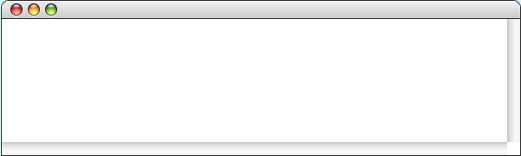
4.2. Acronym
An acronym is a word formed by taking the first letter of each word in a sequence, as in
Write a C++ program that generates acronyms, as illustrated by the following sample run:
"self-contained underwater breathing apparatus"
"scuba"
Acronym
Program to generate acronyms
Enter string:
not in my back yard
The acronym is "nimby"
Enter string:
Federal Emergency
The acronym is "FEMA"
Enter string:
Management Agency

Slide 14
4.2. Acronym
string acronym(string str) {
string result = "";
bool inWord = false;
int nc = str.length();
for (int i = 0; i < nc; i++) {
char ch = str[i];
if (inWord) {
if (!isalpha(ch)) inWord = false;
} else {
if (isalpha(ch)) {
result += ch;
inWord = true;
}
}
}
return result;
}

Slide 15
4.3. Translating English to Pig Latin
We describe a C++ program that reads a line of text from the user and then translates each word in that line from English to Pig Latin, a made-up language familiar to most children in the English-speaking world.
In Pig Latin, words are formed from their English counterparts by applying the following rules:
1. If the word contains no vowels (元音), no translation is done, which means that the translated word is the same as the original.
2. If the word begins with a vowel, the function adds the string "way" to the end of the original word.
3. If the word begins with a consonant (辅音), the function extracts the string of consonants up to the first vowel, moves that collection of consonants to the end of the word, and adds the string "ay".

Slide 16


4.3. Translating English to Pig Latin
As an example, suppose that the English word is scram. Because the word begins with a consonant, you divide it into two parts: one consisting of the letters before the first vowel and one consisting of that vowel and the remaining letters:
You then interchange these two parts and add ay at the end, as follows:
Thus the Pig Latin word for scram is amscray. For a word that begins with a vowel, such as apple, you simply add way to the end, which leaves you with appleway.

Slide 17
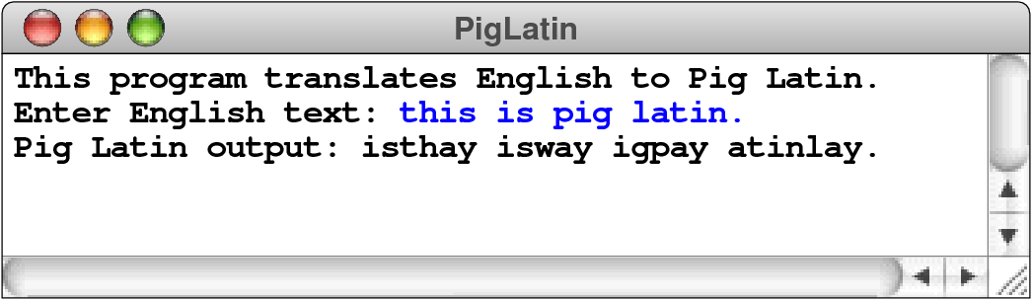
4.3. Translating English to Pig Latin
A sample run of the program might look like this:
It is worth taking a careful look at the implementations of lineToPigLatin and wordToPigLatin. The lineToPigLatin function finds the word boundaries in the input and provides a useful pattern for separating a string into individual words. The wordToPigLatin function uses substr to extract pieces of the English word and then uses concatenation to put them back together in their Pig Latin form. In Chapter 6, you will learn about a more general facility called a token scanner that divides a string into its logically connected parts.

Slide 18
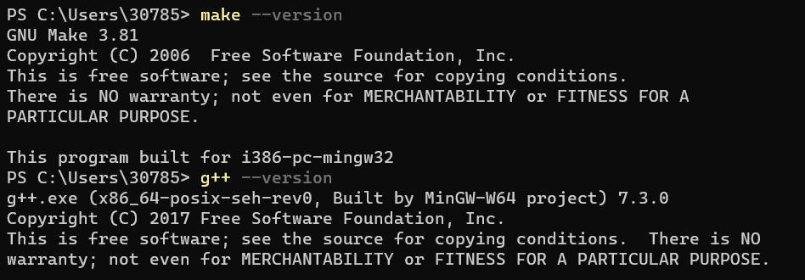
5.1. Run the code via command lines (terminal)
If you don’t know how, or fail to set the VS Code makefile extension (settings.json), you can ALWAYS use COMMAND LINES to compile and run your C++ code.
Only pre-requisite: you can run “make --version” and “g++ --version” in the command lines.

Slide 19
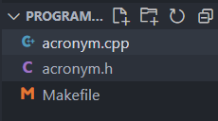
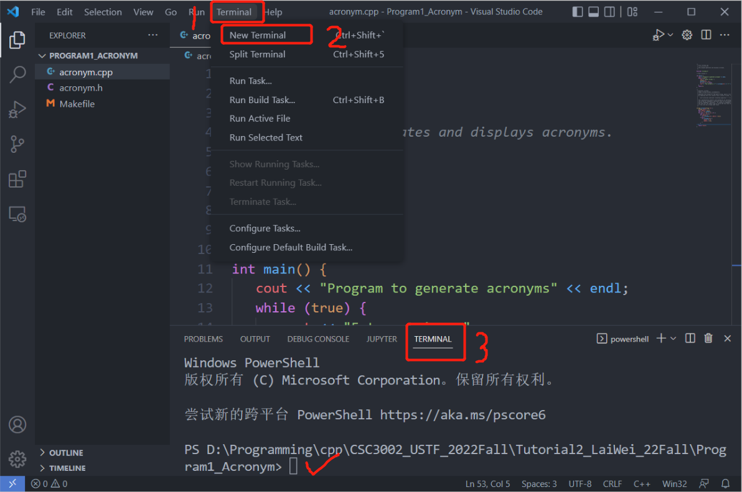
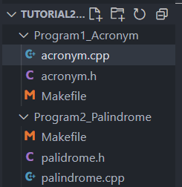
5.1. Run the code via command lines a) Compile by pure command lines, with “g++” compile command
Open a terminal in the current code folder.
Correct: Makefile is in current program folder workspace, no path problem.
Wrong: Makefile in NOT in program folder workspace, may bring relative-path problem.

Slide 20
5.1. Run the code via command lines a) Compile by pure command lines, with “g++” compile command
In the terminal, type compile command:
“g++ -std=c++17 <your source .cpp files> -o <output filename>”
E.g. “g++ -std=c++17 helloworld.cpp foo.cpp -o helloworld”
Then run the executable program:
different terminal have different calling method, maybe:
“./<filename>”, “<filename>” (macOS system)
“./<filename>.exe”, “<filename>.exe” (Windows system)

Slide 21
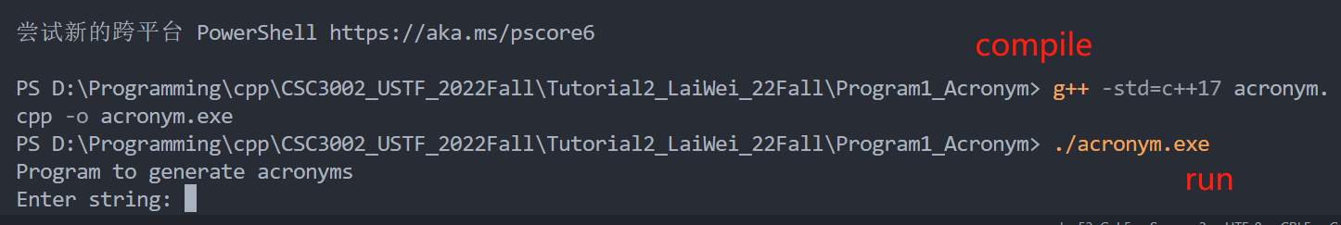
5.1. Run the code via command lines a) Compile by pure command lines, with “g++” compile command
Use <ctrl>(command) + C to exit the program.

Slide 22
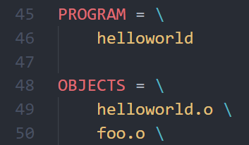
5.1. Run the code via command lines b) Compile by pure command lines, with “makefile”.
Write your own “Makefile” script, or use the template given. (If you use Prof Kinley’s template, remember to change two names!)
In the terminal, type make command:
“make” (or “mingw32-make.exe”, if you use Qt’s make tool)
Then run the executable program:
different terminal have different calling method, maybe:
“./<filename>”, “<filename>” (macOS system)
“./<filename>.exe”, “<filename>.exe” (Windows system)

Slide 23
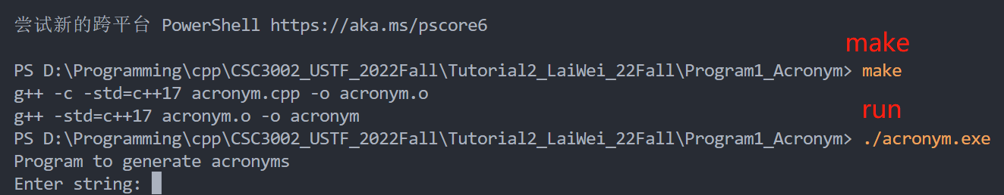
5.1. Run the code via command lines b) Compile by pure command lines, with “makefile”.
Use <ctrl>(command) + C to exit the program.

Slide 24
5.1. Run the code via command lines b) Compile by pure command lines, with “makefile”.
One useful tip: Use “↑” “↓”(Up/down arrows on the keyboard) to view command history.
Two useful tips: Use “Tab” for Automatic completion the command / filename
(Demo)

Slide 25
5.2. Run the code via VS Code make-extension
A fact behind the make-extension: it automatically generates commands in terminal for you after you pressing the “build” “run” button. In the first time you press the button, it automatically generates configurations for you (in “.vscode/settings.json”).
If it succussed, you can use the button to compile and run your program.
But if it failed, you need to manually set the proper path settings (in “.vscode/settings.json”).
But, you can ALWAYS use COMMAND LINES to compile and run your C++ code.

Slide 26
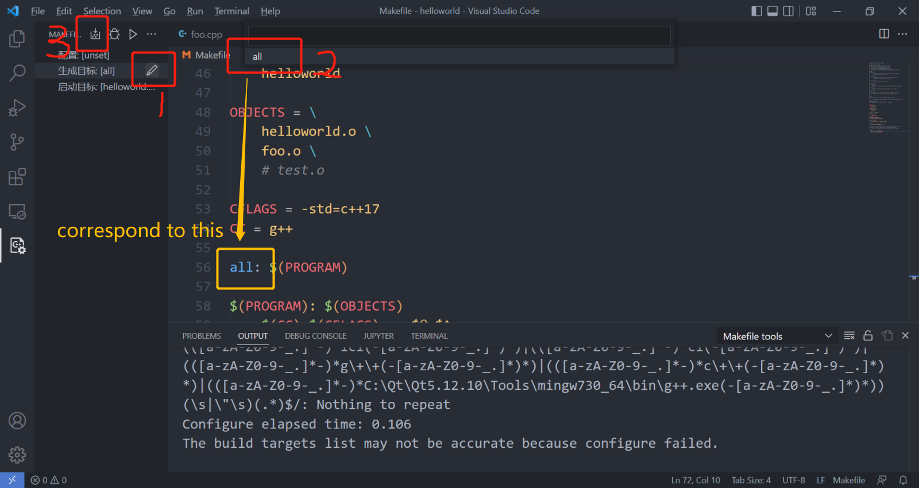
5.2. Run the code via VS Code make-extension
You can first directly use the buttons to compile and run your program without setting path in “settings.json”. The Extension will automatically detect and generate the settings for you. If you find the setting path is not correct, view next-next slide for solution.
Build:

Slide 27
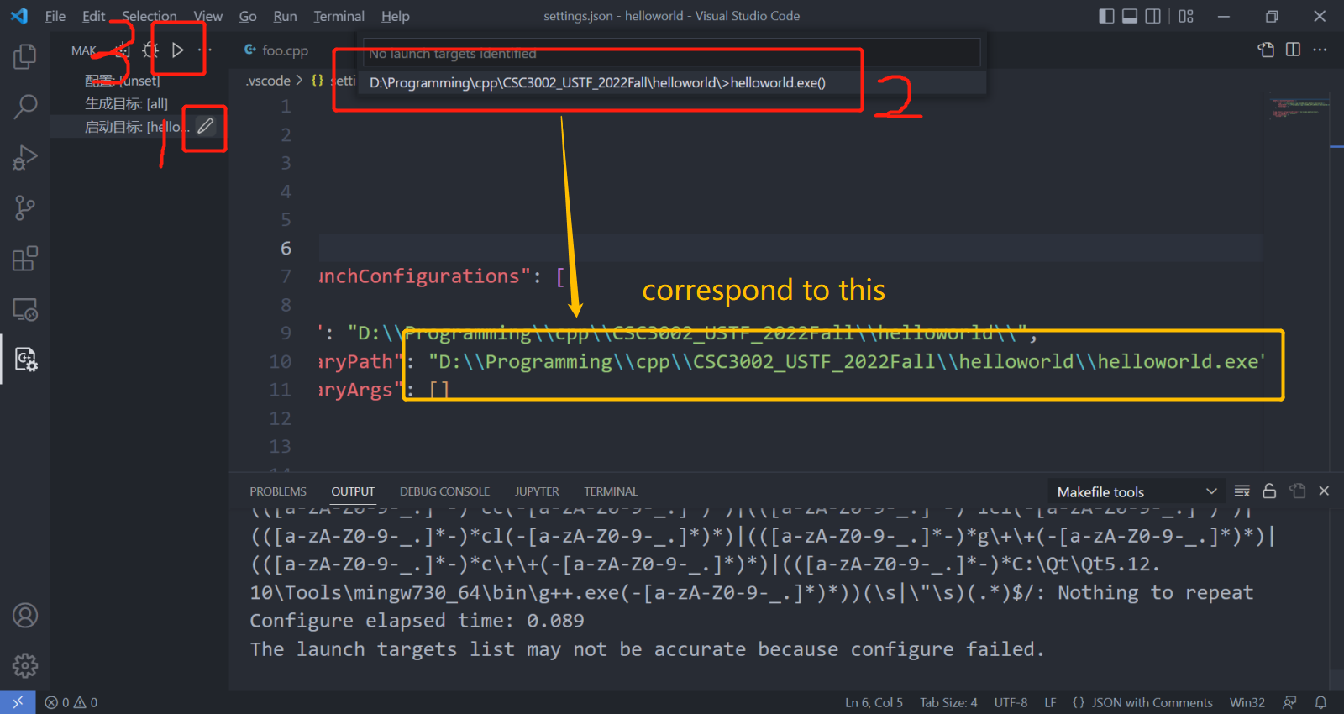
5.2. Run the code via VS Code make-extension
Run:

Slide 28
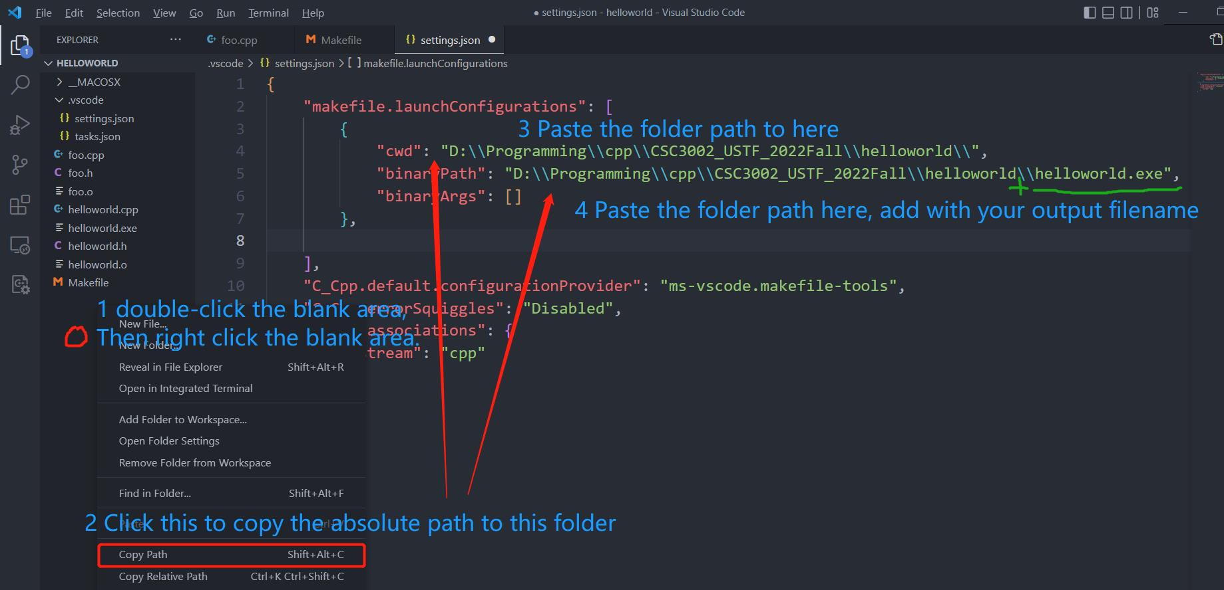
5.2. Run the code via VS Code make-extension
If you find the auto-generated setting path is not correct, you can manually set the path in the “settings.json”:

Slide 29
6. Q & A time
Thank you for your listening!
Lai Wei (USTF)
(SDS, 120090485@link.cuhk.edu.cn)
Office hour: Friday 10:00-11:00 am, Start-up Zone library L103

